Slide 1
Multi Cycle Processor

Slide 2
Single Cycle Processor
Not utilized in modern designs
  Inefficient
  Clock cycle must have the same length for every instruction
  Determined by the longest possible path in the machine
  Several of the instructions could fit in a shorter clock cycle
Jump
R-Type
Load
Instr
Fetch
Instr decode
PC write
Instr
Fetch
Instr decode R read
ALU delay
Reg write
Instr
Fetch
Instr decode R read
ALU delay
Mem read
Reg write
Time wasted
Time wasted
Time wasted

Slide 3
Multi Cycle Processor
Jump
R-Type
Load
Instr
Fetch
Instr decode
PC write
Instr
Fetch
Instr decode R read
ALU delay
Reg write
Instr
Fetch
Instr decode R read
ALU delay
Mem read
Reg write
Clocks

Slide 4
Multi Cycle Approach
Break up the instructions into steps - GOAL
  each step takes one clock cycle
  balance the amount of work to be done in each step/cycle so that they are about equal
  restrict each cycle to use at most once each major functional unit so that such units do not have to be replicated
  functional units can be shared between different cycles within one instruction
Between steps/cycles
  At the end of one cycle store data to be used in later cycles of the same instruction
    need to introduce additional internal (programmer-invisible) registers for this purpose
  Data to be used in later instructions are stored in programmer-visible state elements: the register file, PC, memory

Slide 5
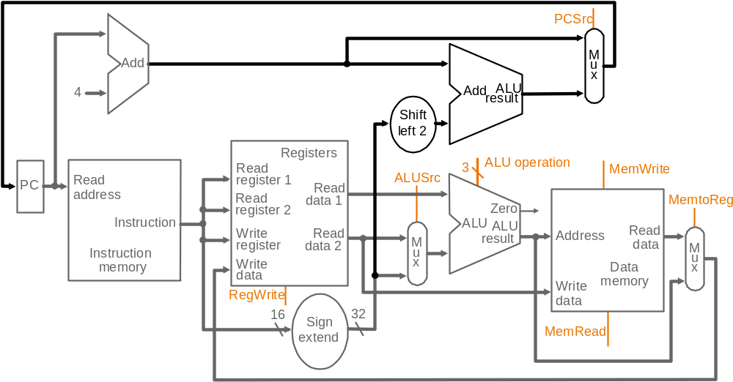
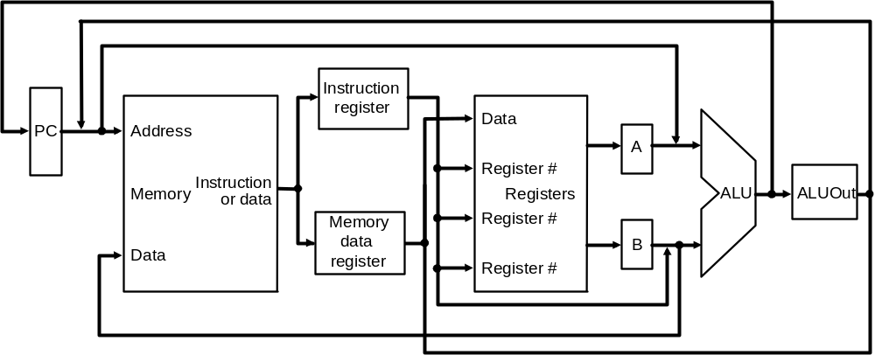
Multicycle Approach
Multicyle vs. single-cycle
diagrams
  single memory for data
  and instructions
  single ALU, no extra adders
  extra registers to
  hold data between
  clock cycles
Single-cycle datapath
Multicycle datapath (high-level view)

Slide 6
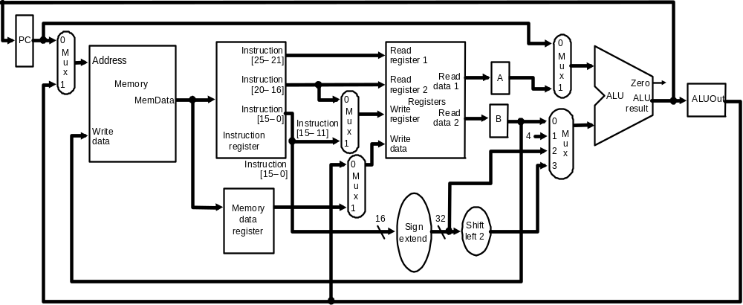
Multicycle Datapath
Basic multicycle MIPS datapath handles R-type instructions and load/stores:
new internal register in blue ovals, new multiplexors in green ovals

Slide 7
Breaking instructions into steps
Break instructions into the potential execution steps
– Not all instructions require all the steps
– Each step takes one clock cycle
  Instruction fetch and PC increment (IF)
  Instruction decode and register fetch (ID)
  Execution, memory address computation, or branch completion (EX)
  Memory access or R-type instruction completion (MEM)
  Memory read completion (WB)
Each MIPS instruction takes from 3 – 5 cycles (steps)

Slide 8
Step 1: Instruction Fetch & PC Increment (IF)
Use PC to get instruction and put it in the instruction register.
Increment the PC by 4 and put the result back in the PC.
Micro operations using RTL (Register-Transfer Language):
IR = Memory[PC];
PC = PC + 4;

Slide 9
Step 2: Instruction Decode and Register Fetch (ID)
Read registers rs and rt if needed
Compute the branch address if the instruction is a branch
RTL:
A = Reg[IR[25-21]];
B = Reg[IR[20-16]];
ALUOut = PC + (sign-extend(IR[15-0]) << 2);

Slide 10
Step 3: Execution, Address Computation or Branch Completion (EX)
ALU performs one of four functions depending on instruction type
  Memory reference:
  ALUOut = A + sign-extend(IR[15-0]);
  R-type:
  ALUOut = A op B;
  Branch (instruction completes):
  if (A==B) PC = ALUOut;
  Jump (instruction completes):
  PC = PC[31-28] || (IR(25-0) << 2)

Slide 11
Step 4: Memory access or R-type Instruction Completion
(MEM)
Again depending on instruction type:
Loads and stores access memory
  Load
  MDR = Memory[ALUOut];
  Store (instruction completes)
  Memory[ALUOut] = B;
R-type (instructions completes)
Reg[IR[15-11]] = ALUOut;

Slide 12
Step 5: Memory Read Completion (WB)
Again depending on instruction type:
Load writes back (instruction completes)
Reg[IR[20-16]]= MDR;
Important: Need of this step:
There is no reason from a datapath (or control) point of view that Step 5 cannot be eliminated by performing
Reg[IR[20-16]]= Memory[ALUOut]; for loads in Step 4
This would eliminate the MDR as well.
The reason this is not done is that, to keep steps balanced in length, the design restriction is to allow each step to contain at most one ALU operation, or one register access, or one memory access

Slide 13
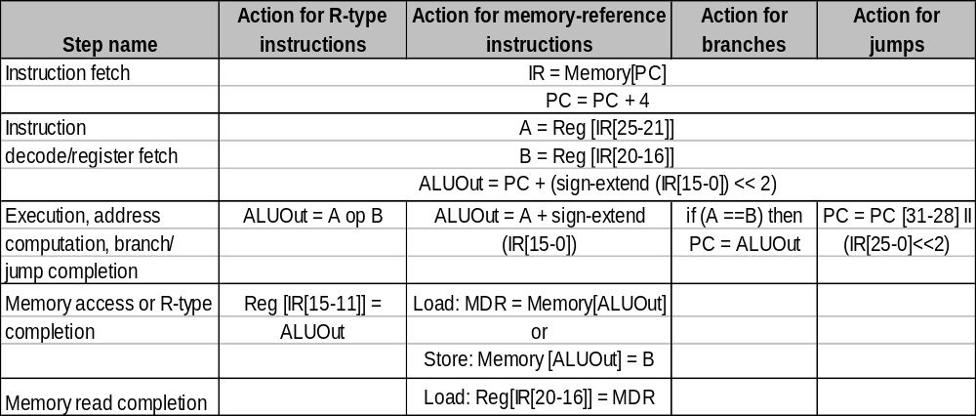
Summary of Instruction Execution
Step
1: IF
2: ID
3: EX
4: MEM
5: WB

Slide 14
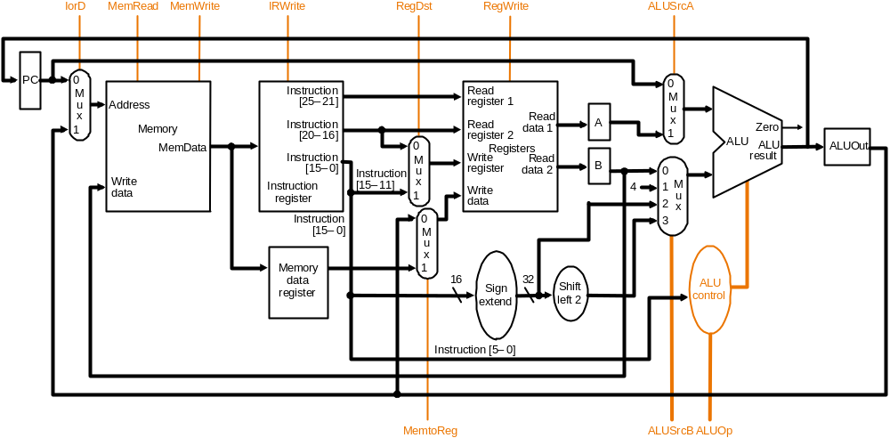
Multicycle Datapath with Control I
… with control lines and the ALU control block added – not all control lines are shown

Slide 15
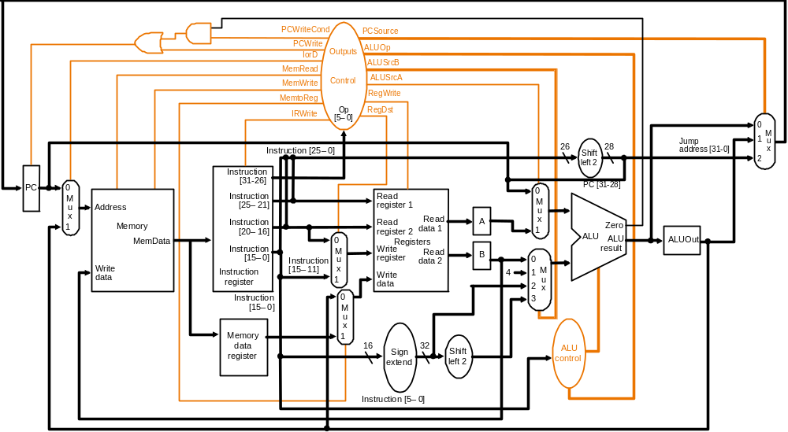
Multicycle Datapath with Control II
New gates
For the jump address
New multiplexor
Complete multicycle MIPS datapath (with branch and jump capability)
and showing the main control block and all control lines

Slide 16
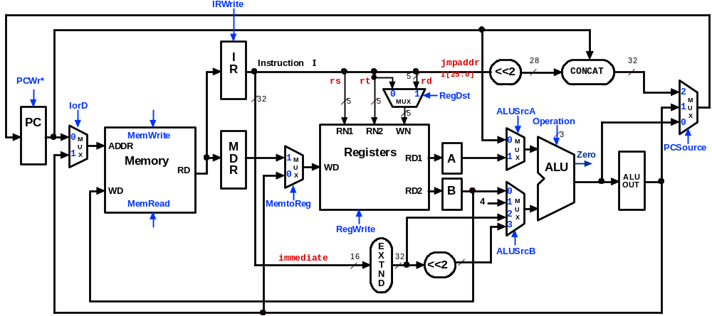
Multicycle Control Step (1):
Fetch
IR = Memory[PC];
PC = PC + 4;
1
1
0
0
0
X
010
0
X
1
0
1

Slide 17
Multicycle Control Step (2):
Instruction Decode & Register Fetch
A = Reg[IR[25-21]]; (A = Reg[rs])
B = Reg[IR[20-15]]; (B = Reg[rt])
ALUOut = (PC + sign-extend(IR[15-0]) << 2);
0
0
X
0
0
X
010
X
X
0
0
3

Slide 18
Multicycle Control Step (3):
Memory Reference Instructions
ALUOut = A + sign-extend(IR[15-0]);
0
0
X
1
0
X
010
X
X
0
0
2

Slide 19
Multicycle Control Step (3):
ALU Instruction (R-Type)
ALUOut = A op B;
0
0
X
1
0
X
???
X
X
0
0
0

Slide 20
Multicycle Control Step (3):
Branch Instructions
if (A == B) PC = ALUOut;
0
1 if
Zero=1
X
1
0
X
011
1
X
0
0
0

Slide 21
Multicycle Execution Step (3):
Jump Instruction
PC = PC[21-28] concat (IR[25-0] << 2);
0
1
X
X
0
X
XXX
2
X
0
0
X

Slide 22
Multicycle Control Step (4):
Memory Access - Read (lw)
MDR = Memory[ALUOut];
0
0
1
X
0
X
XXX
X
X
1
0
X

Slide 23
Multicycle Execution Steps (4)
Memory Access - Write (sw)
Memory[ALUOut] = B;
0
0
1
X
1
X
XXX
X
X
0
0
X

Slide 24
Multicycle Control Step (4):
ALU Instruction (R-Type)
Reg[IR[15:11]] = ALUOut; (Reg[Rd] = ALUOut)
0
IRWrite
0
I
Instruction
I
jmpaddr
28
32
R
5
I[25:0]
<<2
CONCAT
PCWr*
X
rs
rt
rd
0
32
5
5
0
MUX
1
RegDst
X
2
M
IorD
5
1
ALUSrcA
XXX
1
U
PC
Operation
0
X
0
M
MemWrite
RN1
RN2
WN
0
3
U
ADDR
M
1
Registers
M
PCSource
1
X
D
0
RD1
A
1
U
Zero
X
Memory
0
M
WD
X
ALU
RD
R
1
U
X
ALU
WD
RD2
B
0
OUT
MemRead
MemtoReg
4
1
M
1
2
U
RegWrite
3
X
0
1
E
ALUSrcB
immediate
16
X
32
<<2
X
T
N
D

Slide 25
Multicycle Execution Steps (5)
Memory Read Completion (lw)
Reg[IR[20-16]] = MDR;
IRWrite
0
0
I
Instruction
I
jmpaddr
28
32
R
5
I[25:0]
<<2
CONCAT
PCWr*
X
rs
rt
rd
X
0
32
0
1
RegDst
2
IorD
5
5
MUX
0
XXX
1
M
5
ALUSrcA
U
PC
Operation
0
X
0
M
MemWrite
RN1
RN2
WN
0
3
U
ADDR
M
Registers
M
PCSource
1
X
D
0
RD1
A
1
U
Zero
X
Memory
M
WD
X
ALU
RD
R
1
U
X
ALU
WD
RD2
B
0
OUT
MemRead
MemtoReg
4
1
M
0
2
U
0
RegWrite
3
X
1
E
ALUSrcB
immediate
16
X
32
<<2
X
T
N
D

Slide 26
Tutorial Questions
How many cycles will it take to execute this code?
lw $t2, 0($t3)
lw $t3, 4($t3)
beq $t2, $t3, Label #assume not equal
add $t5, $t2, $t3
sw $t5, 8($t3)
Label: ...
What is going on during the 8th cycle of execution?
In what cycle does the actual addition of $t2 and $t3 takes place?
Clock time-line

Slide 27
Implementing Control
Up to this, we have determined what control signals are and when they must be asserted
  So, now we can implement the CONTROL UNIT
Value of control signals is dependent upon:
  what instruction is being executed
  which step is being performed

Slide 28
Implementing Control
Single Cycle CPU
  We can use a set of truth tables that specifyd the settings of the controls signals based on the instruction class
Multi Cycle CPU
  The control is more complex
    As the instruction is executed in a series of steps
  We need to specify two things:
    The signals to be set in any step
    The next step in the sequence

Slide 29
Implementing Control
Technique to specify the control
  Finite State machine
    Uses a graphical representation
  Microprogramming
    Uses a programming representation for control
Both techniques uses detailed implementation by gates, ROMs or PLAs

Slide 30
Implementing Control
Use the information we have accumulated to specify a finite state machine
Actual Hardware Implementation is then derived from the specification

Slide 31
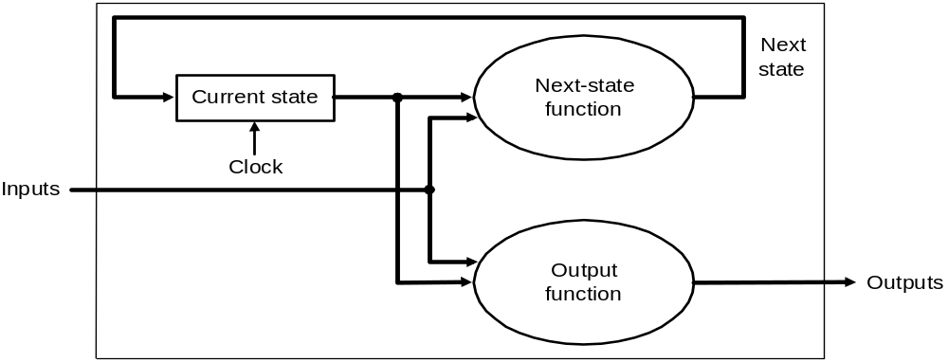
Brief: Finite State Machines
Finite state machines (FSMs):
  A sequential logic function consisting of a set of inputs and outputs, a next state function that maps the current state and the inputs to a new state and an output function that maps the current state and possibly the inputs to a set of asserted outputs
  Moore machine

Slide 32
Brief: Finite State Machines
Finite state machines (FSMs)
  Each state also specifies a set of outputs that are asserted when the machine in that state
  Assumes that all outputs that are not explicitly asserted are deasserted
    No don’t care signals…

Slide 33
Example: Moore Machine
The Moore machine: given input a binary string terminated by “#”, will output “even” if the string has an even number of 0’s and “odd” if the string has an odd number of 0’s

Slide 34
Example: Moore Machine
The Moore machine below, given input a binary string terminated by “#”, will output “even” if the string has an even number of 0’s and “odd” if the string has an odd number of 0’s
Even state
Odd state
1
1
No
output
0
No
output
0
Start
#
#
Output
“even”
Output
“odd”
Output even state
Output odd state

Slide 35
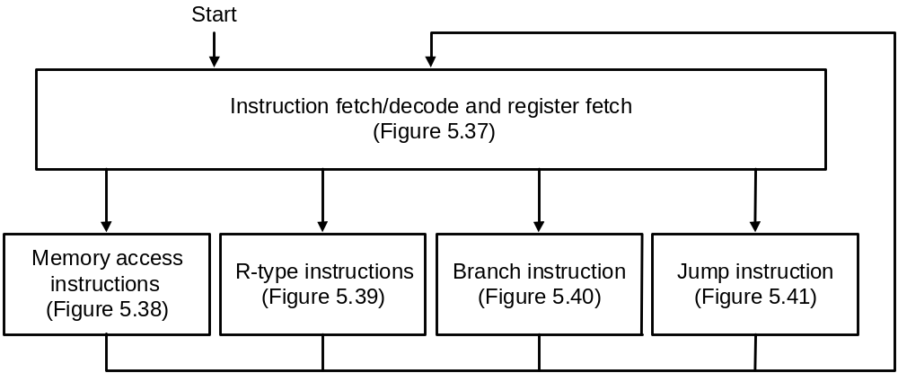
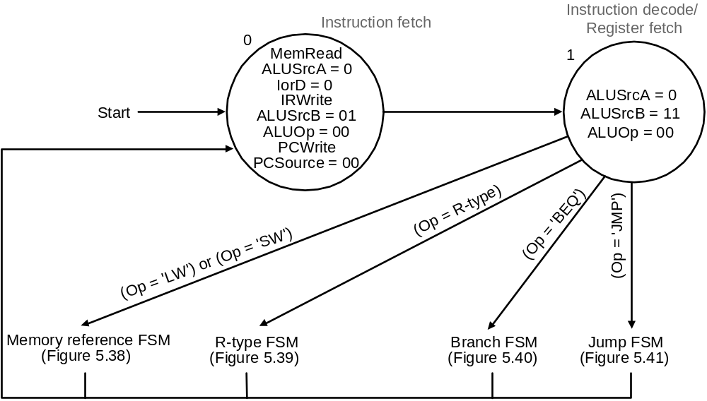
FSM Control: High-level View
High-level view of FSM control
Asserted signals
shown inside
state circles
Instruction fetch and decode steps of every instruction is identical

Slide 36
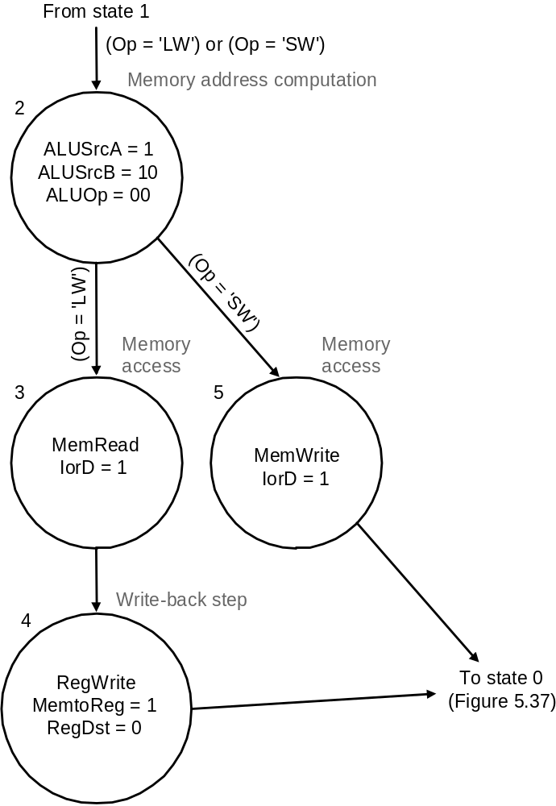
FSM Control: Memory Reference
FSM control for memory-reference has 4 states

Slide 37
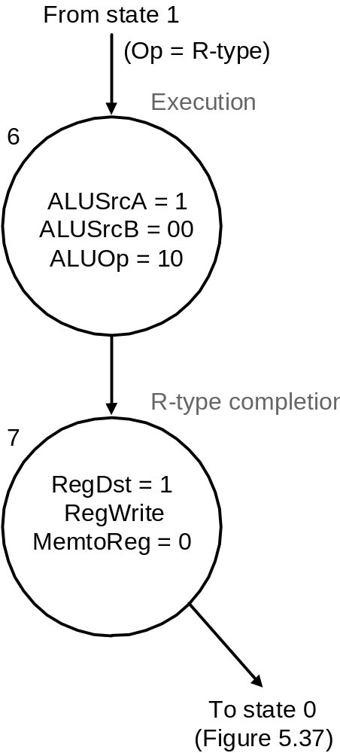
FSM Control: R-type Instruction
FSM control to implement R-type instructions has 2 states

Slide 38
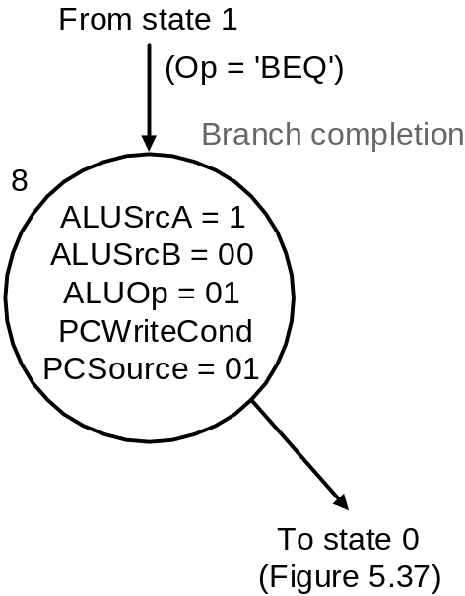
FSM Control: Branch Instruction
FSM control to implement branches has 1 state

Slide 39
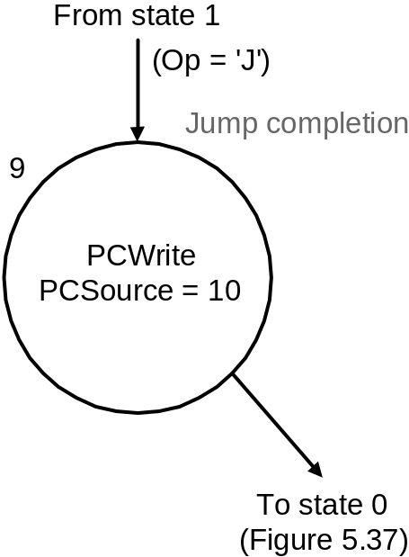
FSM Control: Jump Instruction
FSM control to implement jumps has 1 state

Slide 40
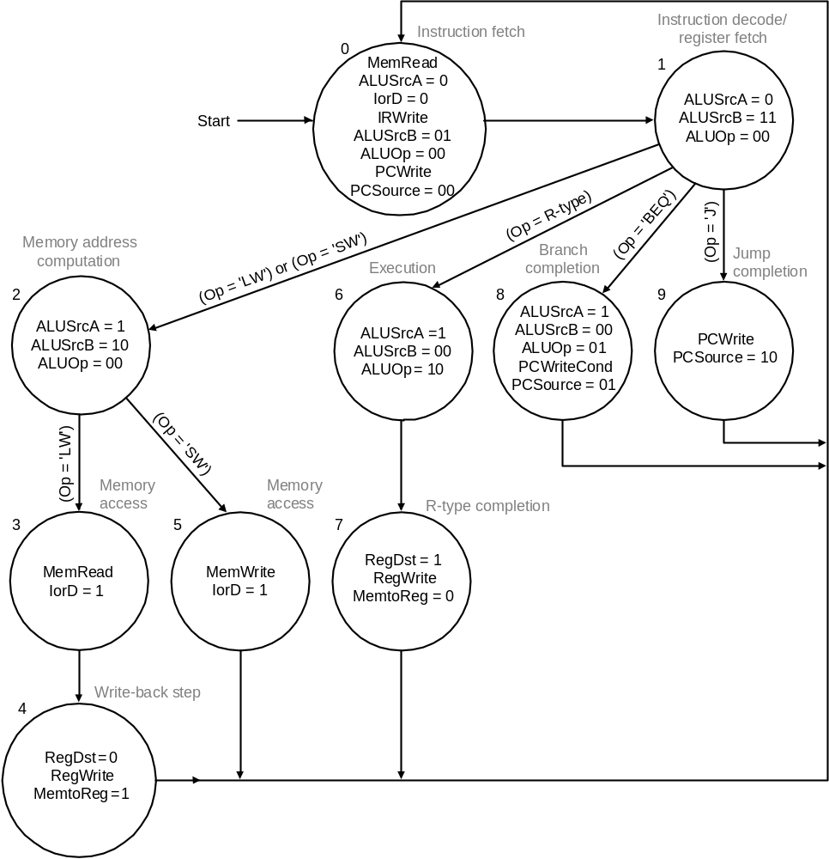
FSM Control: Complete View
IF
ID
EX
MEM
Labels on arcs are conditions
that determine next state
WB
The complete FSM control for the multicycle MIPS datapath:
refer Multicycle Datapath with Control II

Slide 41
FSM Control: Implementation
Requires
  A temporary register that holds the current state
  A block of combinational logic that determines both the data path signals to be asserted as well as the next state

Slide 42
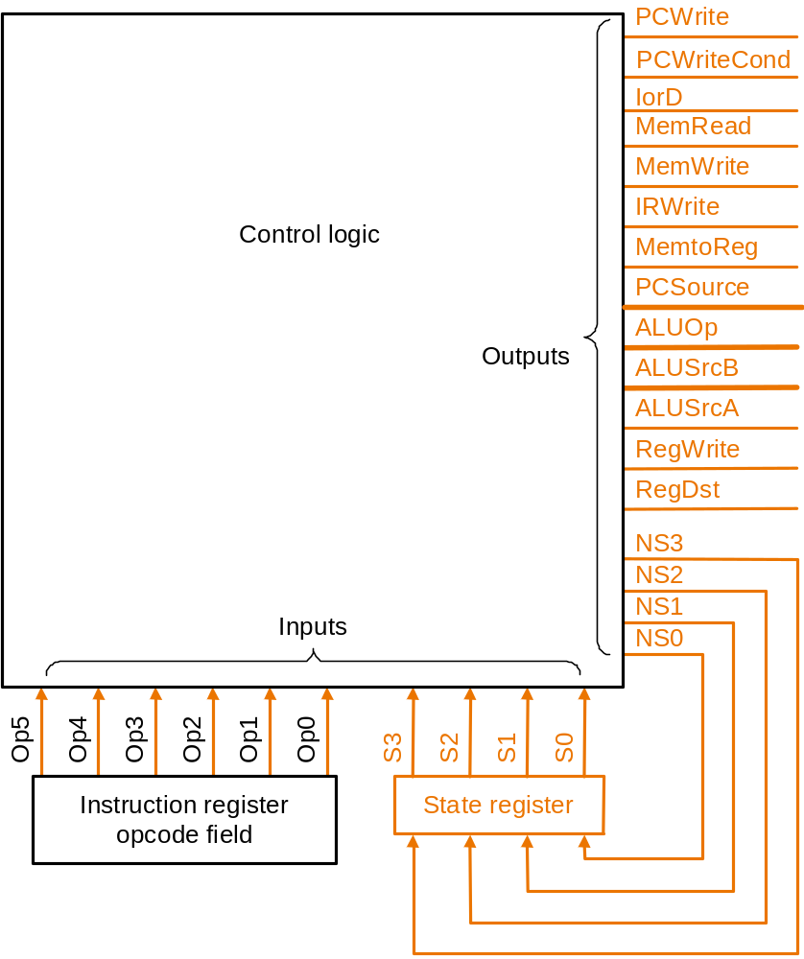
FSM Control:
Implementation
Four state bits are required for 10 states
High-level view of FSM implementation: inputs to the combinational logic block are
the current state number and instruction opcode bits; outputs are the next state
number and control signals to be asserted for the current state

Slide 43
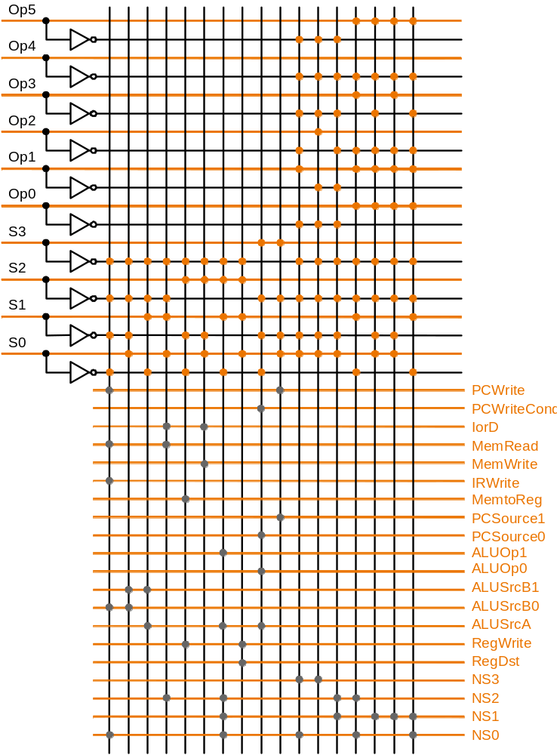
FSMControl:
PLA
Implementation
Upper half is the AND plane that computes all the products. The products are carried
to the lower OR plane by the vertical lines. The sum terms for each output is given by
the corresponding horizontal line
E.g., IorD = S0.S1.S2.S3 + S0.S1.S2.S3

Slide 44
FSM Control: ROM Implementation
ROM (Read Only Memory)
  values of memory locations are fixed ahead of time
A ROM can be used to implement a truth table
  if the address is m-bits, we can address 2^{m} entries in the ROM
  outputs are the bits of the entry the address points to
address
output
0 0 0 0 0 1 1
0 0 1 1 1 0 0
0 1 0 1 1 0 0
0 1 1 1 0 0 0
1 0 0 0 0 0 0
1 0 1 0 0 0 1
1 1 0 0 1 1 0
1 1 1 0 1 1 1
m
n
ROM
m = 3
n = 4
The size of an m-input n-output ROM is 2^{m} x n bits – such a ROM can
be thought of as an array of size 2^{m} with each entry in the array being
n bits

Slide 45
Microprogramming
Microprogramming is a method of specifying FSM control that resembles a programming language – textual rather graphic
  Appropriate when the FSM becomes very large, e.g., if the instruction set is large and/or the number of cycles per instruction is large
  In such situations graphical representation becomes difficult as there may be thousands of states and even more arcs joining them
  A microprogram is specification : implementation is by ROM or PLA

Slide 46
“Microinstruction” Interpretation
User program
plus Data
this can change!
Main
Memory
ADD
SUB
AND
.
.
.
DATA
one of these is
mapped into one
of these
execution
unit
CPU
control
memory
AND microsequence
e.g., Fetch
Calc Operand Addr
Fetch Operand(s)
Calculate
Save Answer(s)

Slide 47
Microprogramming
A microprogram is a sequence of microinstructions
  each microinstruction has eight fields (label + 7 functional)
    Label: used to control microcode sequencing
    ALU control: specify operation to be done by ALU
    SRC1: specify source for first ALU operand
    SRC2: specify source for second ALU operand
    Register control: specify read/write for register file
    Memory: specify read/write for memory
    PCWrite control: specify the writing of the PC
    Sequencing: specify choice of next microinstruction

Slide 48
Microprogramming
The Sequencing field value determines the execution order of the microprogram
  value Seq : control passes to the sequentially next microinstruction
  value Fetch : branch to the first microinstruction to begin the next MIPS instruction, i.e., the first microinstruction in the microprogram
  value Dispatch i : branch to a microinstruction based on control input and a dispatch table entry (called dispatching):
    Dispatching is implemented by means of creating a table, called dispatch table, whose entries are microinstruction labels and which is indexed by the control input. There may be multiple dispatch tables – the value Dispatch i in the sequencing field indicates that the i th dispatch table is to be used

Slide 49
Microprogram
Label ALU SRC1 SRC2 Dest. Memory Mem. Reg. PC Write Sequencing
Fetch: Add PC 4 Read PC IR ALU Seq
Add PC Extshft Dispatch
Rtype: Func rs rt Seq
rd ALU Fetch
Lw: Add rs Extend Seq
Read ALU Seq
rt MEM Fetch
Sw: Add rs Extend Seq
Write ALU Fetch
Beq: Subt. rs rt ALUoutCond. Fetch

Slide 50
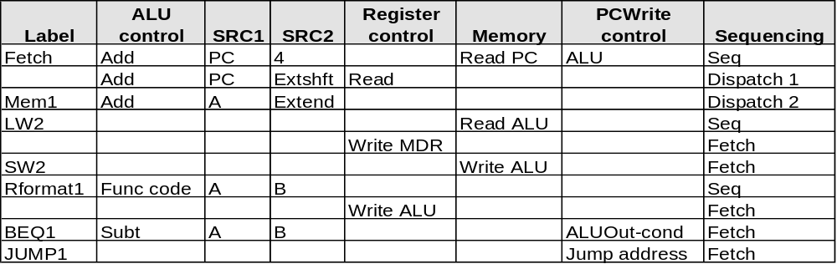
Control Microprogram
The microprogram corresponding to the FSM control shown graphically earlier:
Microprogram containing 10 microinstructions
Dispatch ROM 1
Op
Opcode name
Value
Dispatch ROM 2
000000
R-format
Rformat1
Op
Opcode name
Value
000010
jmp
JUMP1
100011
lw
LW2
000100
beq
BEQ1
101011
sw
SW2
100011
lw
Mem1
Dispatch Table 2
101011
sw
Mem1
Dispatch Table 1

Slide 51
Microprogramming
sequencer
control
datapath control
Inputs
μ-Code ROM
microinstruction (μ)
μ-sequencer:
fetch,dispatch,
sequential
Decode
Decode
micro-PC
Dispatch
ROM
To DataPath
Opcode
Microprogramming is a fundamental concept
  implement an instruction set by building a very simple processor and interpreting the instructions

Slide 52
Specific Sequencer
Sequencer-based control unit
  Called “microPC” or “µPC” vs. state register
Code Name Effect
00 fetch Next µaddress = 0
01 dispatch Next µaddress = dispatch ROM
10 seq Next µaddress = µaddress + 1
ROM:
1
R-type 000000 0100
BEQ 000100 0011
ori 001101 0110
LW 100011 1000
SW 101011 1011
Adder
microPC
Mux
2
1
0
0
µAddress
Select
Logic
ROM
Opcode

Slide 53
Microcode: Trade-offs
Specification advantages
  easy to design and write
  typically manufacturer designs architecture and microcode in parallel
Implementation advantages
  easy to change since values are in memory (e.g., off-chip ROM)
  can emulate other architectures
  can make use of internal registers
Implementation disadvantages
  control is implemented nowadays on same chip as processor so the advantage of an off-chip ROM does not exist
  ROM is no longer faster than on-board cache
  there is little need to change the microcode as general-purpose computers are used far more nowadays than computers designed for specific applications

Slide 54
From Patterson Book
2nd Edition Copy – Refer from beginning to point 5.5(including)
Not to refer: 5.5 onwards…

Slide 55
Summary
Techniques described in this chapter to design datapaths and control are at the core of all modern computer architecture
Multicycle datapaths offer two great advantages over single-cycle
  functional units can be reused within a single instruction if they are accessed in different cycles – reducing the need to replicate expensive logic
  instructions with shorter execution paths can complete quicker by consuming fewer cycles
Modern computers, in fact, take the multicycle paradigm to a higher level to achieve greater instruction throughput:
  pipelining (next topic) where multiple instructions execute simultaneously by having cycles of different instructions overlap in the datapath
  the MIPS architecture was designed to be pipelined

Slide 56
Tutorial Question
Example: CPI in a multicycle CPU
  Assume
    the control design of the previous slide
    An instruction mix of 22% loads, 11% stores, 49% R-type operations, 16% branches, and 2% jumps
  What is the CPI assuming each step requires 1 clock cycle?

Slide 57
Tutorial
Example: CPI in a multicycle CPU
Assume
  the control design of the previous slide
  An instruction mix of 22% loads, 11% stores, 49% R-type operations, 16% branches, and 2% jumps
What is the CPI assuming each step requires 1 clock cycle?
Solution:
  Number of clock cycles from previous slide for each instruction class:
    loads 5, stores 4, R-type instructions 4, branches 3, jumps 3
  CPI = CPU clock cycles / instruction count
  = Σ (instruction count_{class i} × CPI_{class i}) / instruction count
  = Σ (instruction count_{class I} / instruction count) × CPI_{class I}
  = 0.22 × 5 + 0.11 × 4 + 0.49 × 4 + 0.16 × 3 + 0.02 × 3
  = 4.04

Slide 58
FSM Control: ROM vs. PLA
First improve the ROM: break the table into two parts
  4 state bits give the 16 output signals – 2⁴ x 16 bits of ROM
  all 10 input bits give the 4 next state bits – 2¹⁰ x 4 bits of ROM
  Total – 4.3K bits of ROM
PLA is much smaller
  can share product terms
  only need entries that produce an active output
  can take into account don't cares
PLA size = (#inputs × #product-terms) + (#outputs × #product-terms)
  FSM control PLA = (10x17)+(20x17) = 460 PLA cells
PLA cells usually about the size of a ROM cell (slightly bigger)

Slide 59
Overview of Microprogrammed Control Unit
Control may be designed using one of several initial representations.
The choice of sequence control, and how logic is represented, can then be determined independently; the control can then be implemented with one of several methods using a structured logic technique.
Initial Representation Finite State Diagram Microprogram
Sequencing Control Explicit Next State Microprogram counter
Function + Dispatch ROMs
Logic Representation Logic Equations Truth Tables
Implementation PLA ROM
Technique
“hardwired control”
“microprogrammed control”

Slide 60
CORRECTIONs are required
NOT TO FOLLOW SLIDES FROM 56 onwards

Slide 61
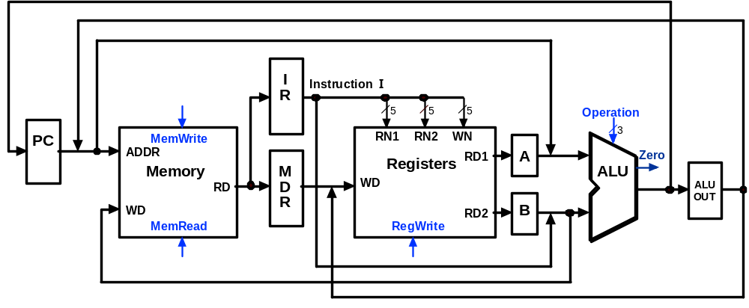
Multicycle Execution Step (1):
Instruction Fetch
IR = Memory[PC];
PC = PC + 4;
4
PC + 4

Slide 62
Multicycle Execution Step (2):
Instruction Decode & Register Fetch
A = Reg[IR[25-21]]; (A = Reg[rs])
B = Reg[IR[20-15]]; (B = Reg[rt])
ALUOut = (PC + sign-extend(IR[15-0]) << 2)
Reg[rs]
Branch
Target
Address
PC + 4
Reg[rt]

Slide 63
Multicycle Execution Step (3):
Memory Reference Instructions
ALUOut = A + sign-extend(IR[15-0]);
Reg[rs]
Mem.
Address
PC + 4
Reg[rt]

Slide 64
Multicycle Execution Step (3):
ALU Instruction (R-Type)
ALUOut = A op B
Reg[rs]
R-Type
Result
PC + 4
Reg[rt]

Slide 65
Multicycle Execution Step (3):
Branch Instructions
if (A == B) PC = ALUOut;
Reg[rs]
Branch
Target
Address
Branch
Target
Address
Reg[rt]

Slide 66
Multicycle Execution Step (3):
Jump Instruction
PC = PC[31-28] concat (IR[25-0] << 2)
Reg[rs]
Branch
Target
Address
Jump
Address
Reg[rt]

Slide 67
Multicycle Execution Step (4):
Memory Access - Read (lw)
MDR = Memory[ALUOut];
Reg[rs]
Mem.
Address
PC + 4
Mem.
Data
Reg[rt]

Slide 68
Multicycle Execution Step (4):
Memory Access - Write (sw)
Memory[ALUOut] = B;
Reg[rs]
PC + 4
Reg[rt]

Slide 69
Multicycle Execution Step (4):
ALU Instruction (R-Type)
Reg[IR[15:11]] = ALUOUT
Reg[rs]
R-Type
Result
PC + 4
Reg[rt]

Slide 70
Multicycle Execution Step (5):
Memory Read Completion (lw)
Reg[IR[20-16]] = MDR;
Reg[rs]
Mem.
Address
PC + 4
Mem.
Data
Reg[rt]

